Slide 1

Monitoring
Claude Falguière
Valtech Paris
#DV14 #Monitoring
@cfalguiere

Slide 2

Content
DevOps is broader than tooling
Data & New challenges for monitoring
Monitoring stories and practices
Tooling
Individuals and interactions over processes and tools
#DV14 #Monitoring
@cfalguiere

Slide 3


Claude Falguiere
#DV14 #Monitoring
@cfalguiere

Slide 4
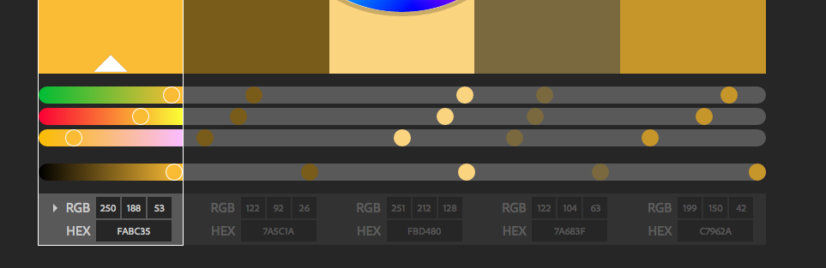
monochromatic
#DV14 #Monitoring
@cfalguiere

Slide 5
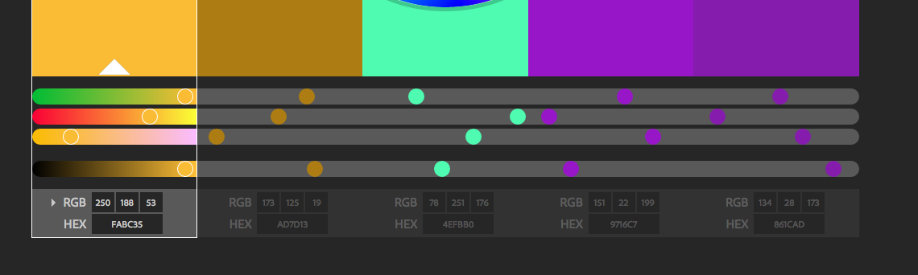
triad
#DV14 #Monitoring
@cfalguiere

Slide 6
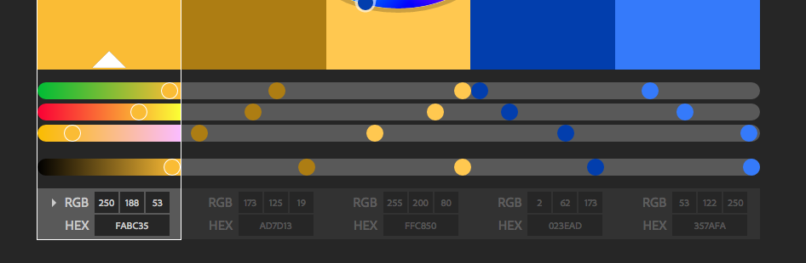
#DV14 #Monitoring
@cfalguiere

Slide 7
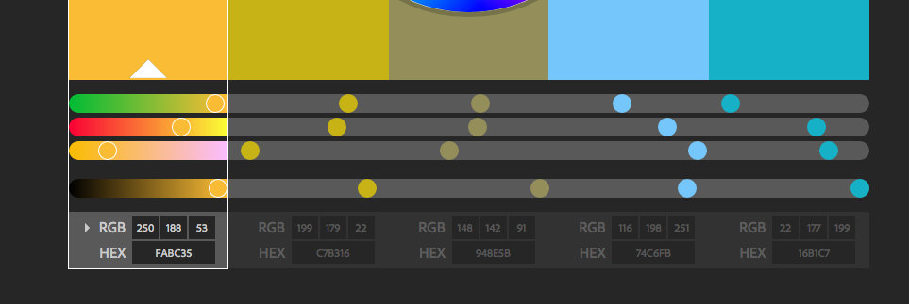
#DV14 #Monitoring
@cfalguiere

Slide 8
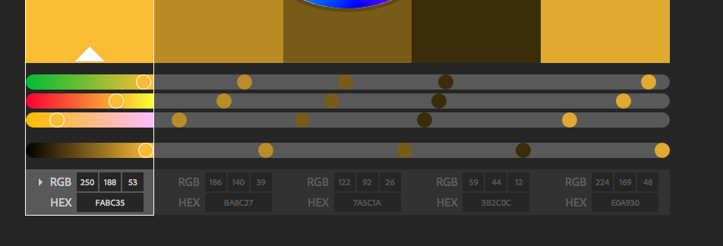
#DV14 #Monitoring
@cfalguiere

Slide 9
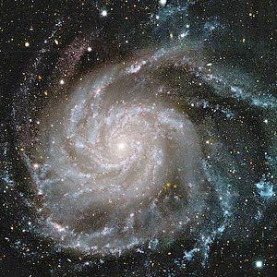
Story of Dark Matter discovery
Inconsistency between speed and mass of spiral galaxies
Intuition of a missing element
Model
#DV14 #Monitoring
@cfalguiere

Slide 10
data -> hypohesis -> model -> decisions -> questions
new data -> new hypothesis -> change in model
#DV14 #Monitoring
@cfalguiere

Slide 11
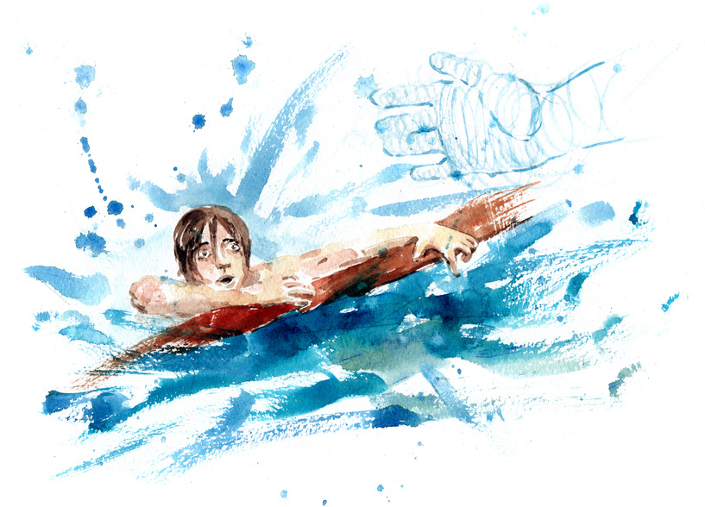
Measure Everything
Don’t Guess
Make decisions based on facts
You may not be aware of the data you will need later
Data
Facts
Decision
#DV14 #Monitoring
@cfalguiere

Slide 12
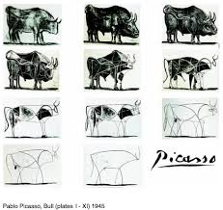
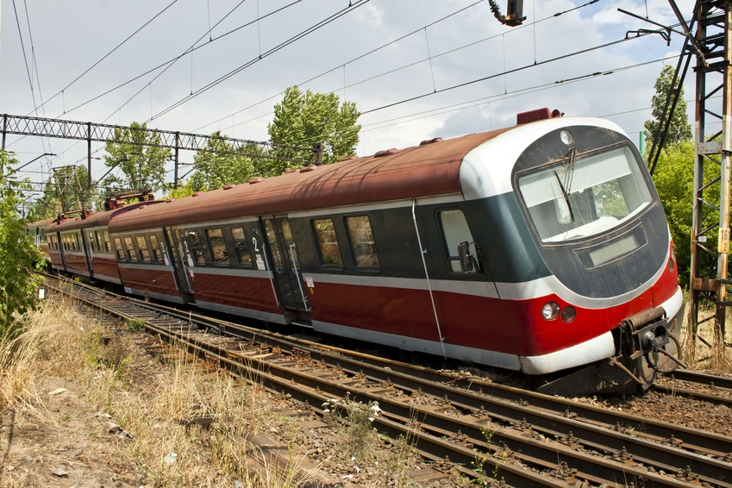
New paradigms
Continuous Improvement
Design for Failure
#DV14 #Monitoring
@cfalguiere

Slide 13
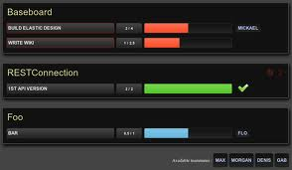
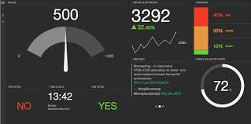
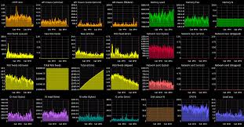
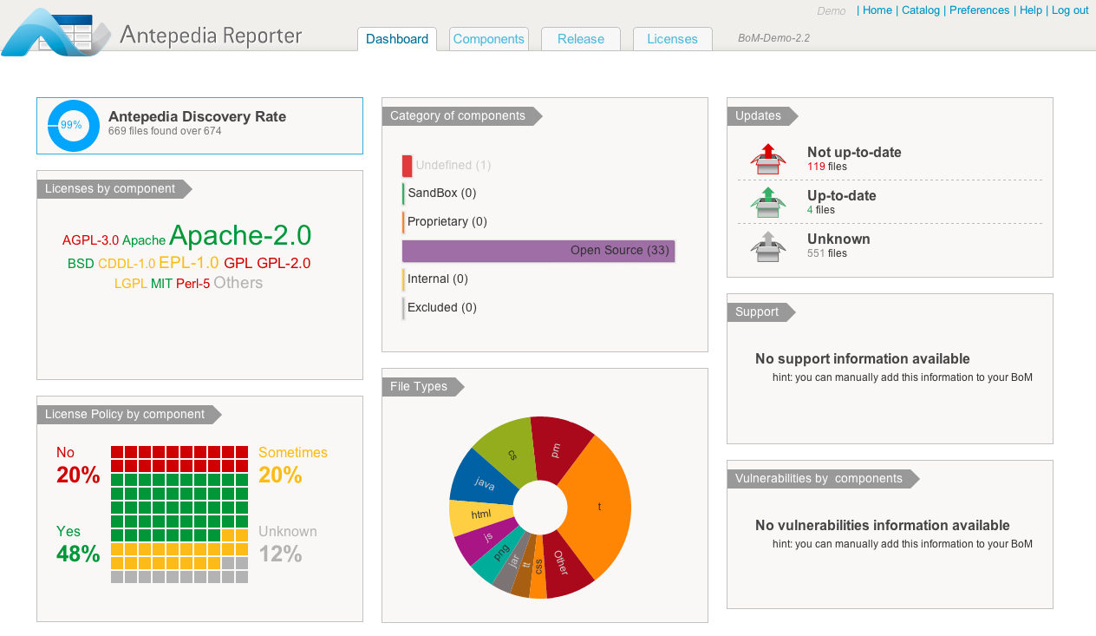
Collect and Share
Many targets
  Support
  Ops
  Dev
  Business
Collect Once and share
Freshness
#DV14 #Monitoring
@cfalguiere

Slide 14
(Quick) Survey about monitoring
1
What ?
2
Ops should take care of that !
3
1 GB of this crap !
2013-12-17 05:53:16,208 INFO [org.jboss.mail.MailService] (main) Mail Service bound to java:/Mail2013-12-17 05:53:16,247 ERROR [org.jboss.kernel.plugins.dependency.AbstractKernelController] (main) Error installing to Real: name=vfsfile:/opt/jboss/jbepp-51/profiles/fr-si-ba-a/custom-deploy/oneweb-fr-bas/oneweb-fr-ear-service.xml state=PreReal mode=Manual requiredState=Realorg.jboss.deployers.spi.DeploymentException: Error deploying: jboss:type=Service,name=OneWebSystemProperties at org.jboss.deployers.spi.DeploymentException.rethrowAsDeploymentException(DeploymentException.java:49) at org.jboss.system.deployers.ServiceDeployer.deploy(ServiceDeployer.java:118) at org.jboss.system.deployers.ServiceDeployer.deploy(ServiceDeployer.java:46) at org.jboss.deployers.spi.deployer.helpers.AbstractSimpleRealDeployer.internalDeploy(AbstractSimpleRealDeployer.java:62) at org.jboss.deployers.spi.deployer.helpers.AbstractRealDeployer.deploy(AbstractRealDeployer.java:55) at org.jboss.deployers.plugins.deployers.DeployerWrapper.deploy(DeployerWrapper.java:179)
!
Lean Startup : build, measure, learn
#DV14 #Monitoring
@cfalguiere

Slide 15
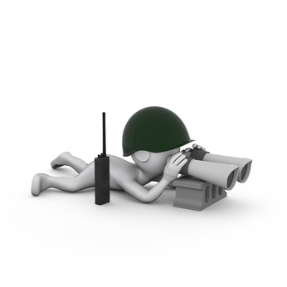

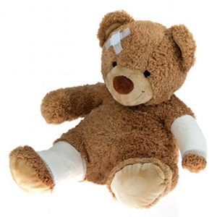

Why Ops can’t take care
Supervision
Monitoring
Alerting
SLA observance
Troubleshooting
Capacity Planning
Analytics
#DV14 #Monitoring
@cfalguiere

Slide 16


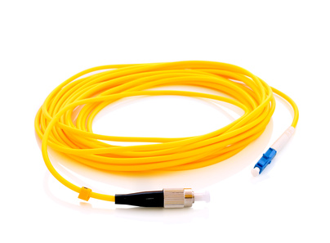
Why Ops can’t take care
Your
App
]
Server
Network
#DV14 #Monitoring
@cfalguiere

Slide 17
You should take care
... Your goals
... Your technical stack
... Your knowledge of the business
]
#DV14 #Monitoring
@cfalguiere

Slide 18
Troubleshooting divination game
Web site’s pages are slow
Throw away Hibernate and use stored procedures
Windows sucks, switch to Linux !
DBA
Project Leader
Linux Guy
Switch to AngularJS
#DV14 #Monitoring
@cfalguiere

Slide 19


Troubleshooting divination game
Web site’s pages are slow
Firewall unexpected behavior
Throw away Hibernate and use stored procedures
Windows sucks, switch to Linux !
DBA
Project Leader
Linux Guy
Switch to AngularJS
#DV14 #Monitoring
@cfalguiere

Slide 20

From number to information
Number
Metric
Indicator
Information
Unit, Context
Acceptable Range
Description, Reader
#DV14 #Monitoring
@cfalguiere

Slide 21

Surveiller
Alerter
Auditer
Prévoir
Améliorer
ce qui améliore la compréhension du processus
  répartition du temps
  masses et répétitions
  parcours utilisateur
  contexte
écouter les utilisateurs, les ops, les devs
écouter les données
#DV14 #Monitoring
@cfalguiere

Slide 22
Surveiller
Alerter
Auditer
Prévoir
Améliorer
la présence
l’usage
les ressources qui peuvent être une limite
  physique : CPU, mémoire, disque, réseau...
  configurable : pools, queues, caches
les autres
les erreurs
L’activité : nombre d’utilisateurs, de commandes ...
#DV14 #Monitoring
@cfalguiere

Slide 23
Opérateur
Sonde
Alerting
App
Analyseur
de logs
Logs
#DV14 #Monitoring
@cfalguiere

Slide 24
Opérateur
Sonde
Collecte Historisation
Alerting
App
Analyseur
de logs
Logs
#DV14 #Monitoring
@cfalguiere

Slide 25
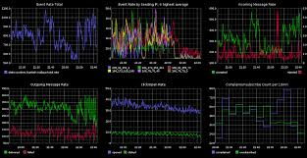
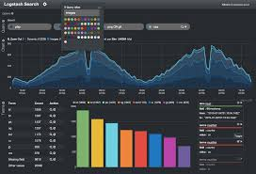
#DV14 #Monitoring
@cfalguiere

Slide 26
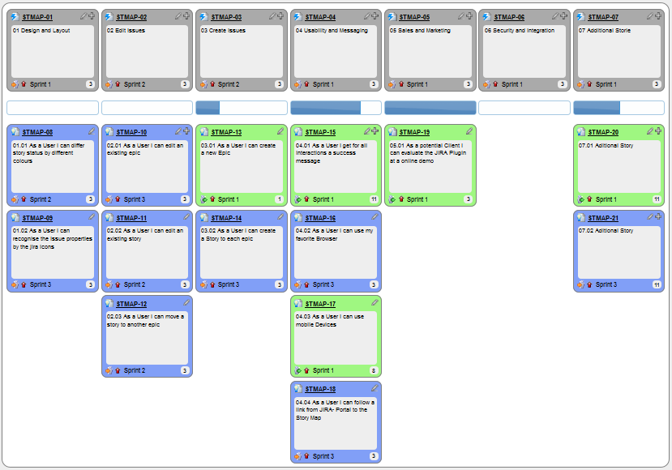
Monitoring User Stories
surveiller
alerter
auditer
anticiper
améliorer
#DV14 #Monitoring
@cfalguiere

Slide 27
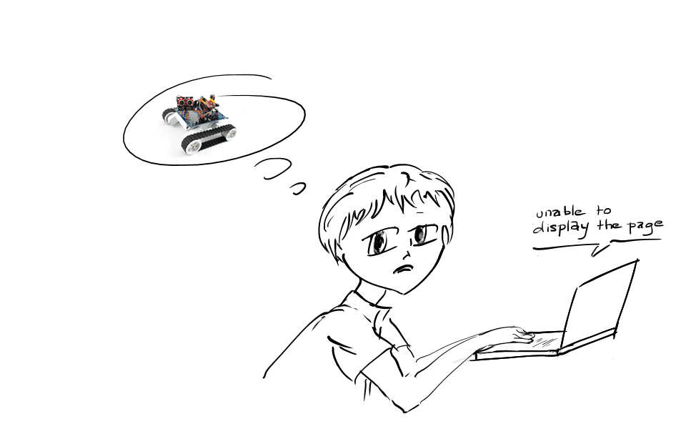
What would you do if you knew that
app is not responding
#DV14 #Monitoring
@cfalguiere

Slide 28
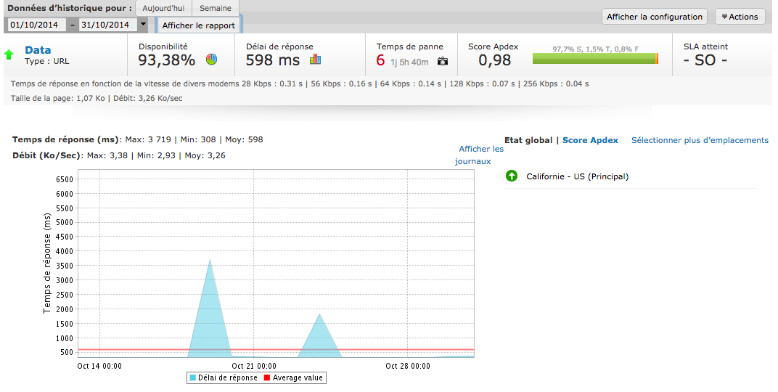
Presence check
Supervision is not Monitoring
  Nagios / Zenoss
  Cloud service (Site24x7, ...)
Alerting : whether, who, when
No memory
CEP
#DV14 #Monitoring
@cfalguiere

Slide 29
What would you do if you knew that
database does not respond anymore
#DV14 #Monitoring
@cfalguiere

Slide 30
Error detection
Event
Log filtering
Context
  is it critical ?
  which feature does it impact ?
  how much ?
#DV14 #Monitoring
@cfalguiere

Slide 31
TODO exemple de log PrintStackTrace
TODO exemple de log un peu mieux
TODO exemple de log clair et validation des logs par les admins
#DV14 #Monitoring
@cfalguiere

Slide 32
What would you do if you knew that
the number of users who pay with a credit card falls
#DV14 #Monitoring
@cfalguiere

Slide 33
Threshold detection
Frequency of an event
Counter passes a threshold
Baselining
CEP
  decrease in number of credit card tickets
  number of ticket within 10:00 and 11:00 should be higher
  credit card presence check fails intermittently
  there is only one payment provider
Business process monitoring
#DV14 #Monitoring
@cfalguiere

Slide 34
Problématiques de gestion de compteurs
MBean Servo
Collecte
#DV14 #Monitoring
@cfalguiere

Slide 35
What would you do if you knew that
number of hits doubles every 3 month
#DV14 #Monitoring
@cfalguiere

Slide 36
Trending
Historisation
Foresight
Cycles
Correlation
#DV14 #Monitoring
@cfalguiere

Slide 37
Historisation
Collecte dans ElasticSearch -> Kibana
Grafana
#DV14 #Monitoring
@cfalguiere

Slide 38
What would you do if you knew that
users don’t find the new killer feature
#DV14 #Monitoring
@cfalguiere

Slide 39
Usage
Web analytics
Page counters
Tagging
#DV14 #Monitoring
@cfalguiere

Slide 40
exemple piwik
#DV14 #Monitoring
@cfalguiere

Slide 41
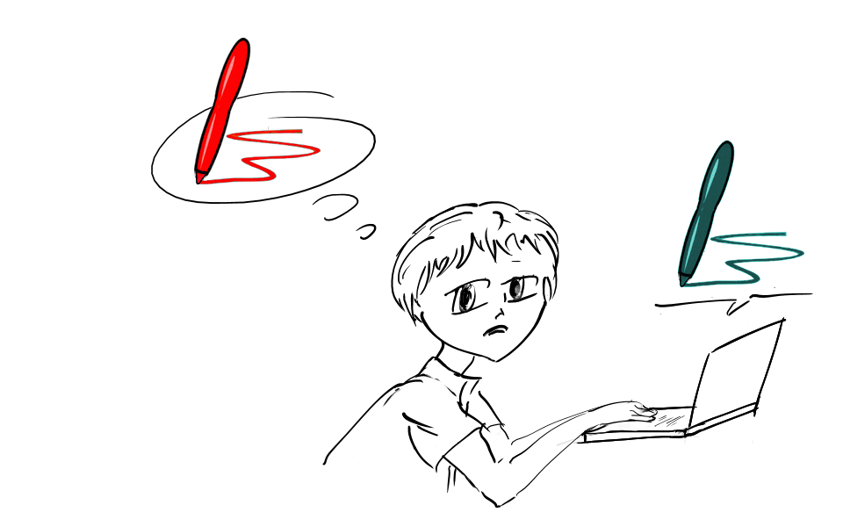
What would you do if you knew that
users search for “red pen” and you only sell blue pen
#DV14 #Monitoring
@cfalguiere

Slide 42
Ad-Hod metrics vs Big Data
Which information is meaningful
Discover valuable metrics
Cost of data munging
Improve collection
Norms and context
#DV14 #Monitoring
@cfalguiere

Slide 43
Ad-Hod metrics
Servo
#DV14 #Monitoring
@cfalguiere

Slide 44

What would you do if you knew that
why the app is slow
#DV14 #Monitoring
@cfalguiere

Slide 45
App performance
Collect a large number of metrics
Wide range of protocols throughout the stack
Out of the box tools and plugins
#DV14 #Monitoring
@cfalguiere

Slide 46
JMX
jstatd
VisualVM
JConsole
#DV14 #Monitoring
@cfalguiere

Slide 47
New monitoring techniques
Flexible
Cross Concern
Shared
Real Time
Easy to use
#DV14 #Monitoring
@cfalguiere

Slide 48
sample architecture
#DV14 #Monitoring
@cfalguiere

Slide 49
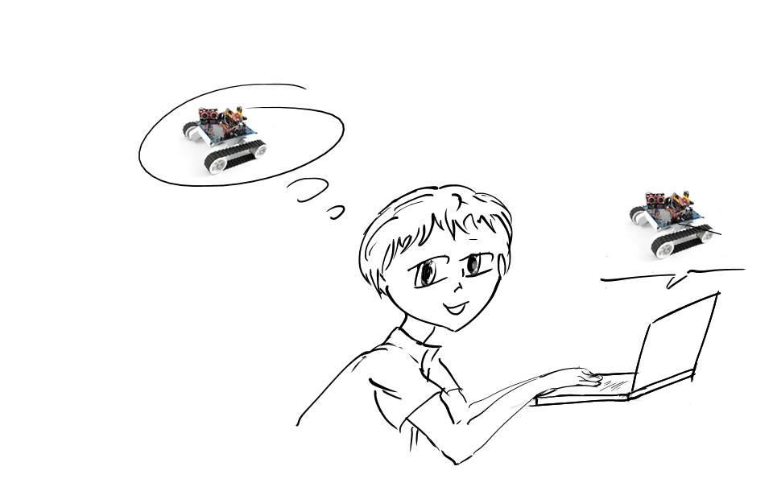
What would you do if you knew
... all about your users
#DV14 #Monitoring
@cfalguiere

Slide 50
Going big
collectors
large database
queues
#DV14 #Monitoring
@cfalguiere

Slide 51
Going data
analytics techniques
data munging : normalization, context
Number -> Metric -> Information
#DV14 #Monitoring
@cfalguiere

Slide 52
data
#DV14 #Monitoring
@cfalguiere

Slide 53
apprendre de ses erreurs
#DV14 #Monitoring
@cfalguiere

Slide 54
fiabilité
double source
interpréter les écarts
  erreur de relevé
  changer le modèle
  inférer un comportement (cache)
  exemple sur des écarts front / back
#DV14 #Monitoring
@cfalguiere

Slide 55
importance du modèle / bigdata
funel model
impact de l’architecture
#DV14 #Monitoring
@cfalguiere

Slide 56
measure everything
#DV14 #Monitoring
@cfalguiere

